Slide 1

A graph data model to study and manage sustainability data.

Slide 2
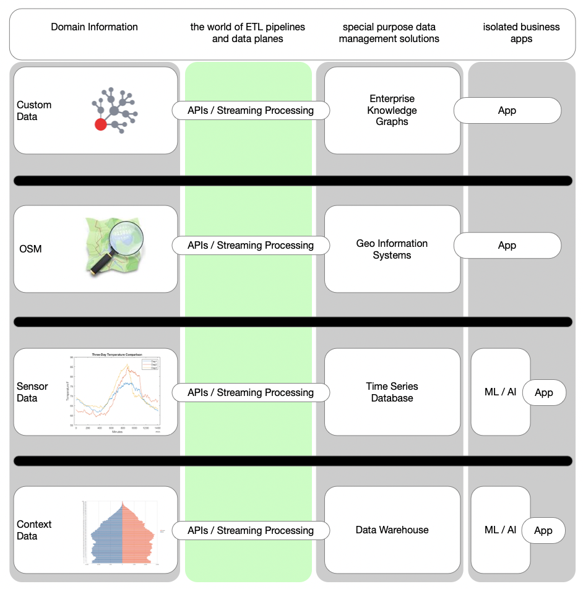
Isolation of data assets
Many public data assets are isolated
Integration of such public data is not easy, even with todays modern data platforms and cloud bases solutions.
One important goal is to overcome the barriers between the application domains.

Slide 3
What are our goals?
Identify, qualify & integrate data to track and measure sustainability and human impact.
1
Highlight missing data coverage to manage analysis bias. Improve data coverage over time in a systematic approach.
2
Illustrate the positive impact of human actions. Support day to day work by simplifying future dataproducts.
3

Slide 4
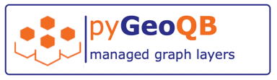
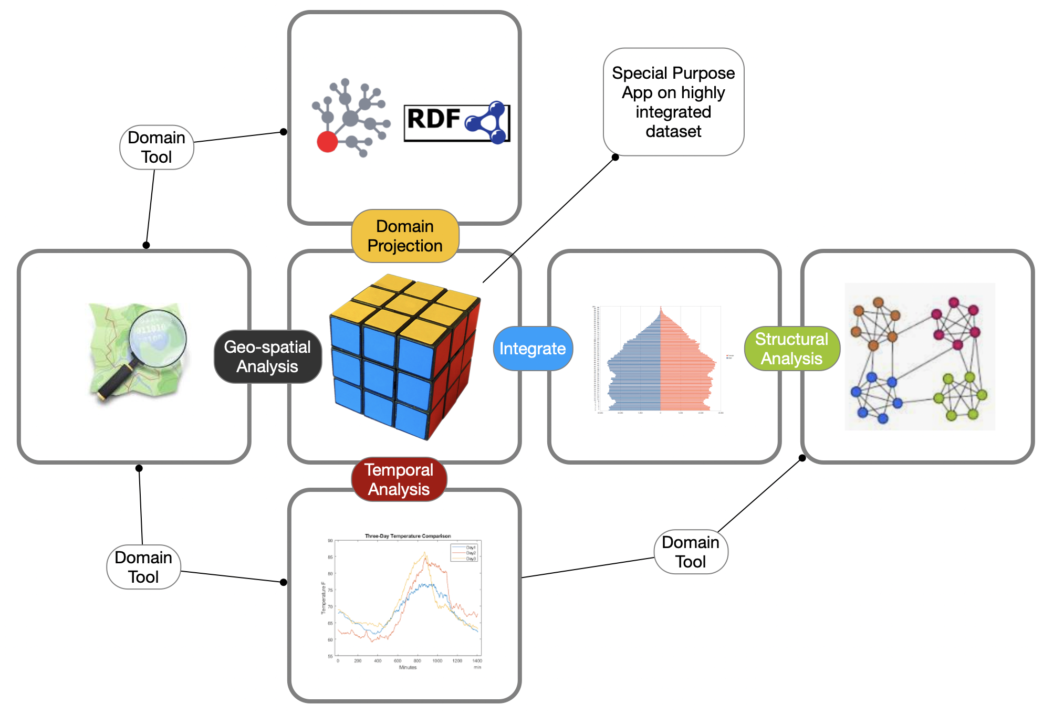

Slide 5
Core Concepts:
Data assets are organized in layers, like in a map.
Individual aspects of a problem can be combined in a layer.
Layers are stackable, each layer has its own meaning or context.
Relevance of layers is defined by weights and impact functions.
Each individual impact profile can lead to specific results.
GeoQB allows personalization and contextualization of data.
This leads to customized information and personalized maps.

Slide 6
Contextualization
Geo-Data:
data is typically provided with lat, lon coordinates (WGS 84)
we use geo-indexing to merge data from multiple domains on custom resolutions
Time Domain
time dependent observations have time stamps
series of observations are managed as episodes with time based indexing

Slide 7
GeoQB Layers
Data layers are defined by queries and semantic data mappings.

Slide 8
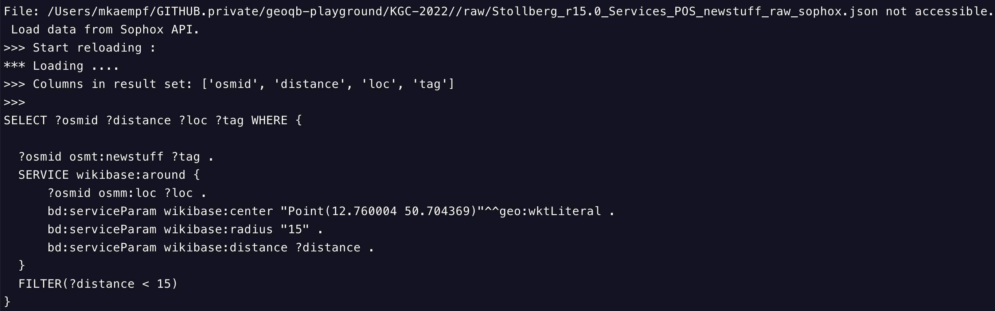
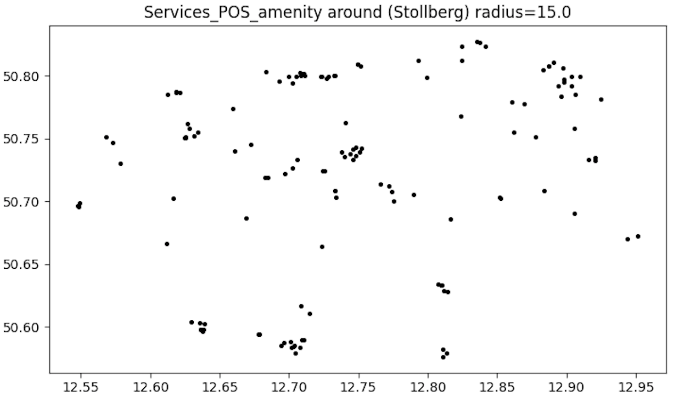
GeoQB Layer
Defined by a SPARQL query.
Buffered in local workspace ➔ ingested into graph data model.

Slide 9
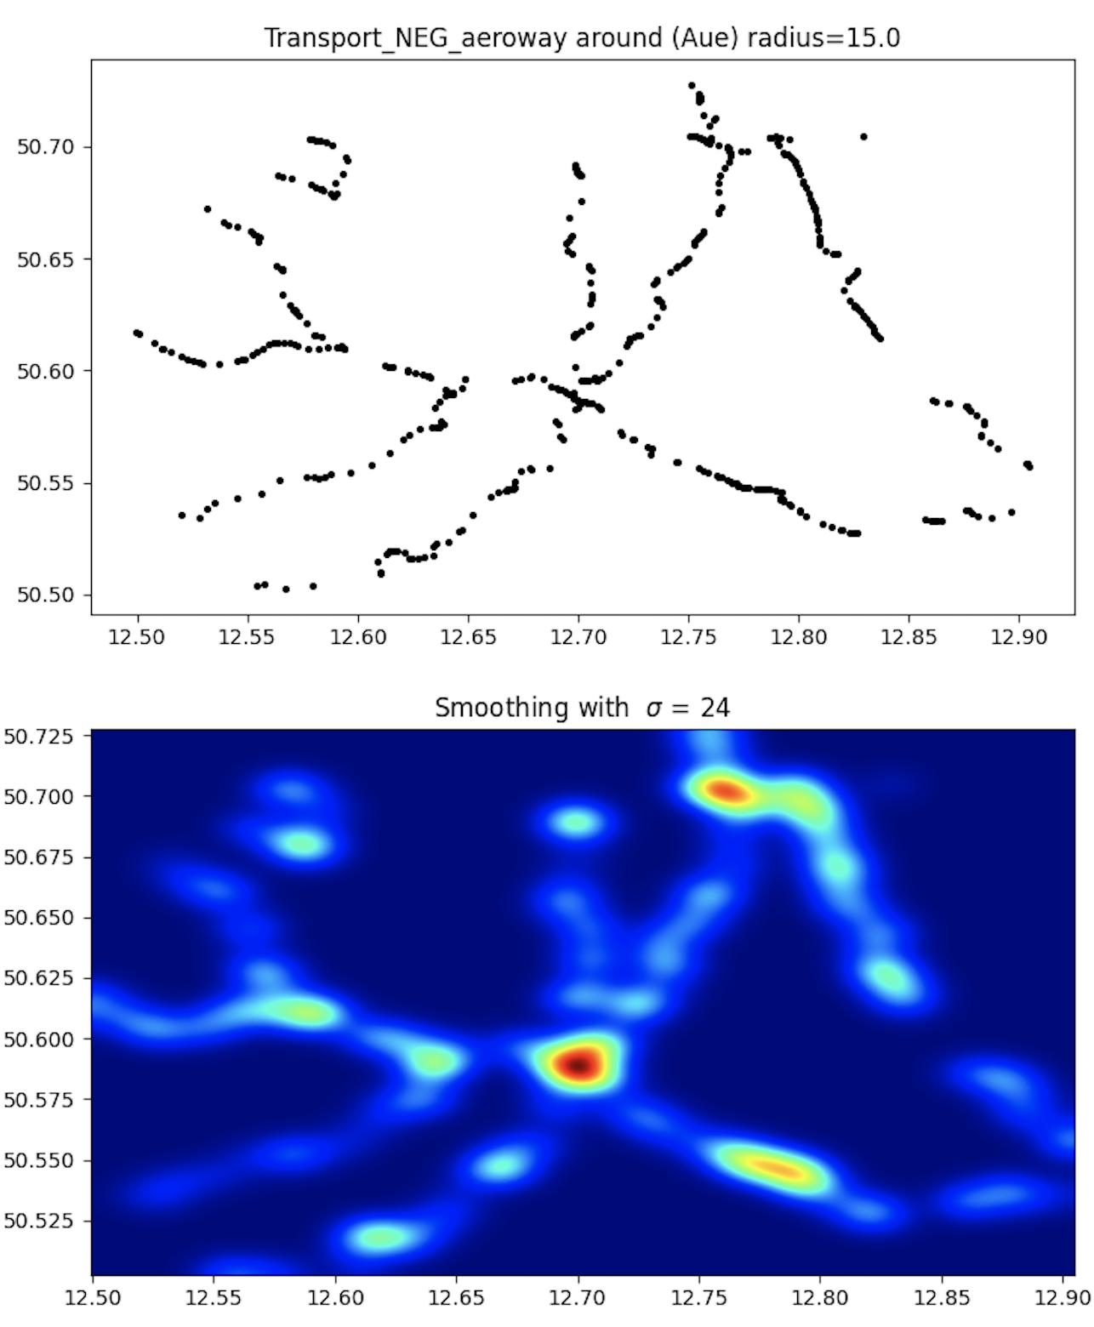
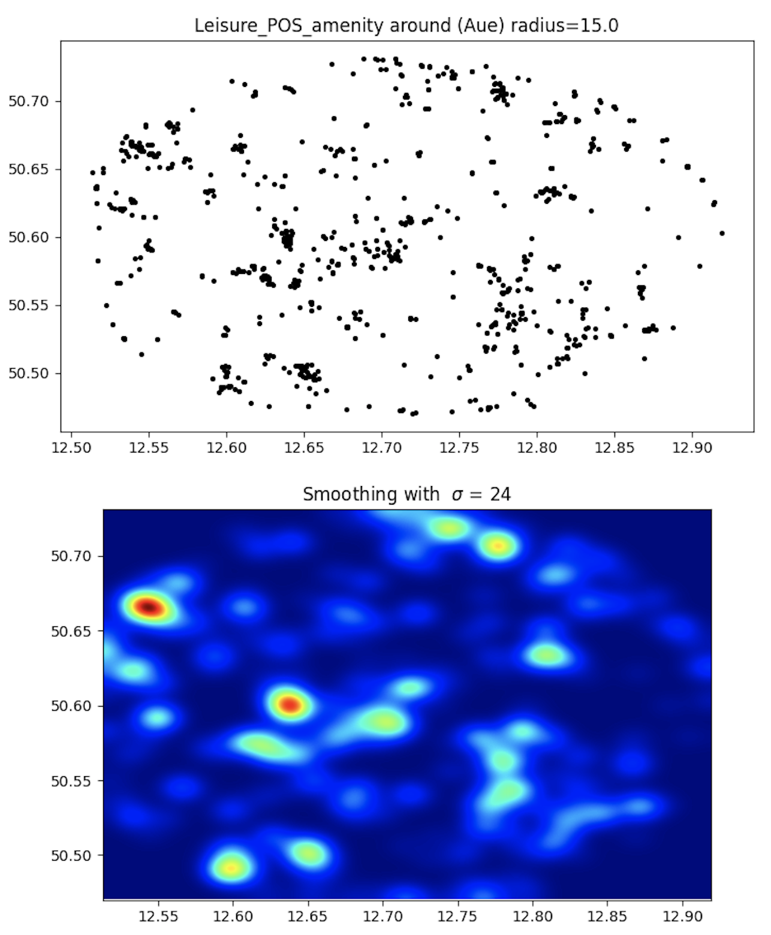

Slide 10
Layer Analysis
Node2Vec based clustering

Slide 11
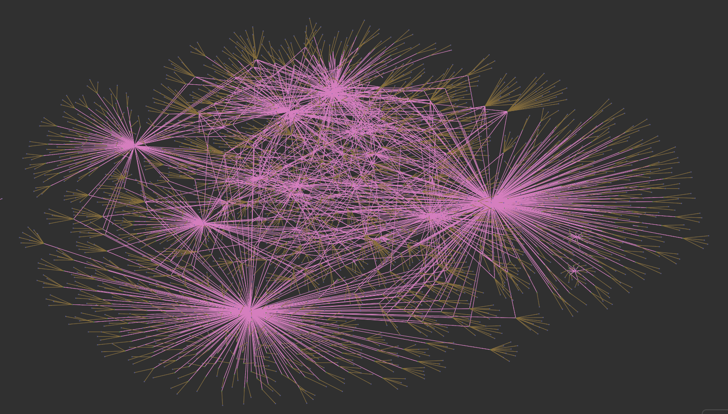
All layers … the backbone of the data model

Slide 12
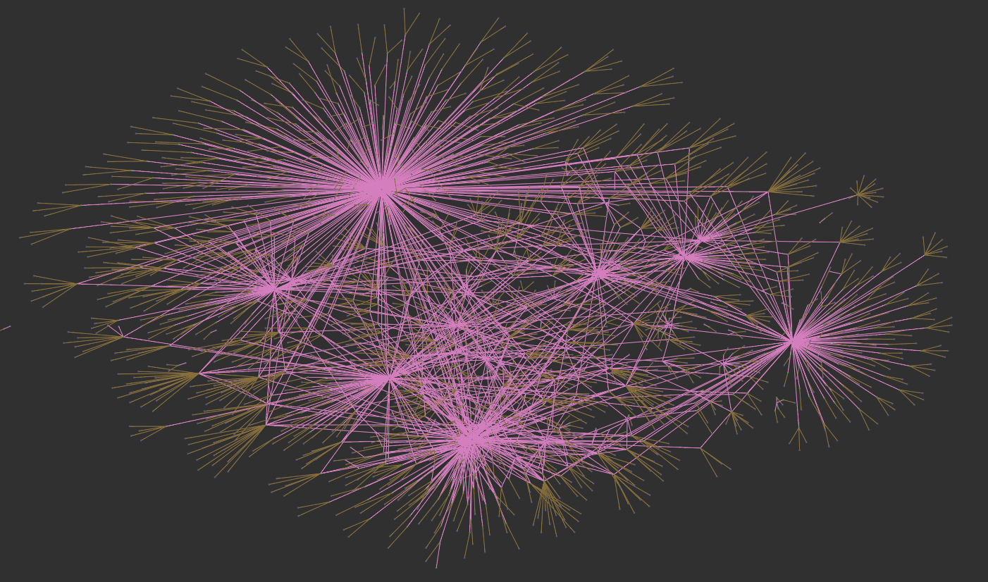
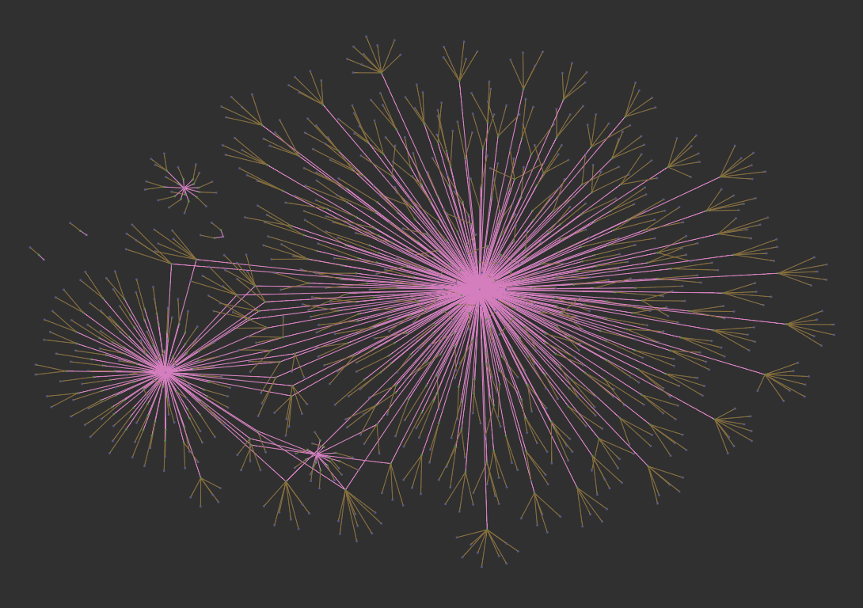
Positive ➔
⬅ Negative

Slide 13
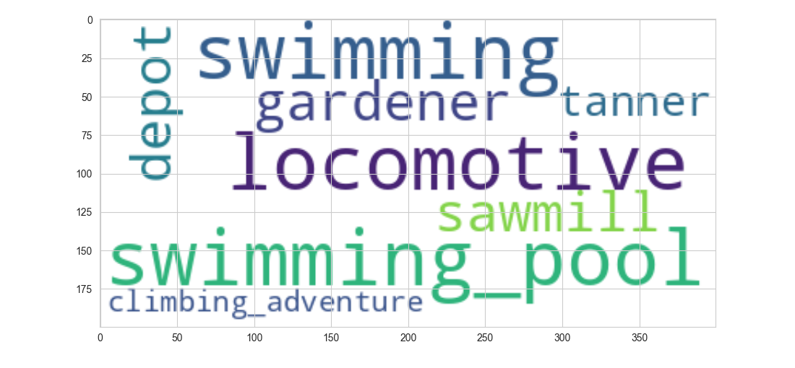
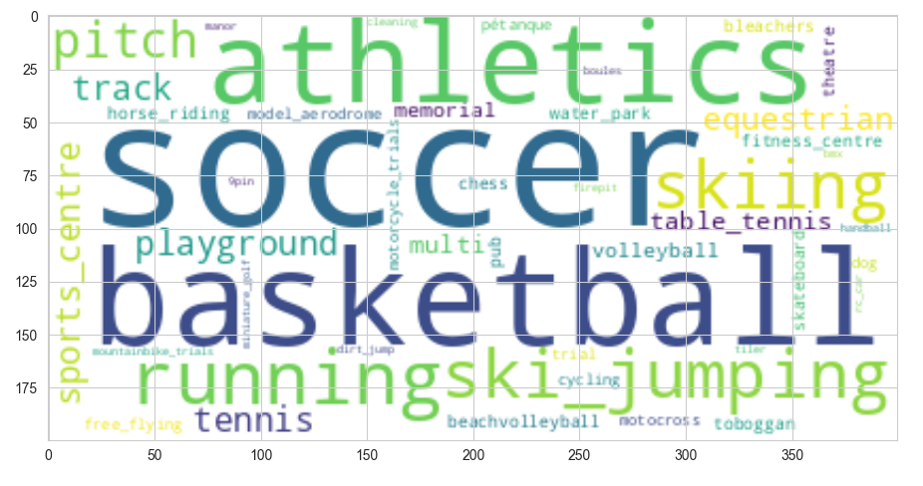
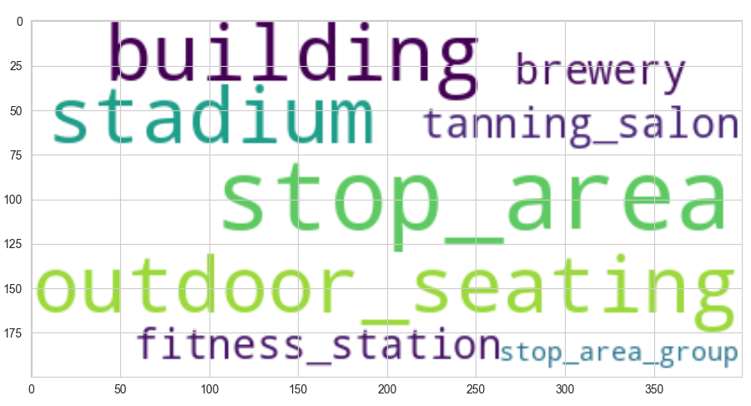
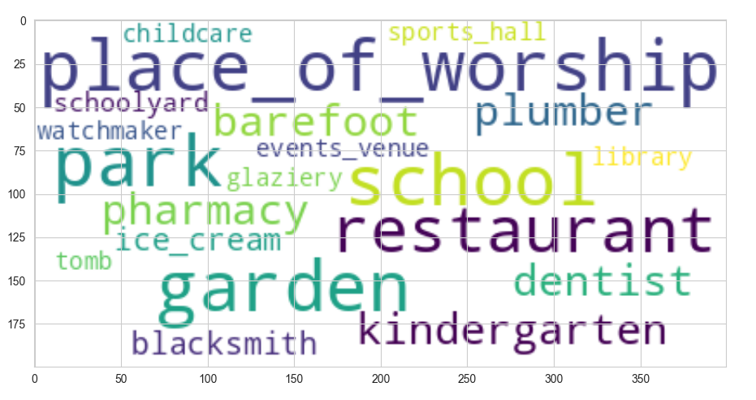
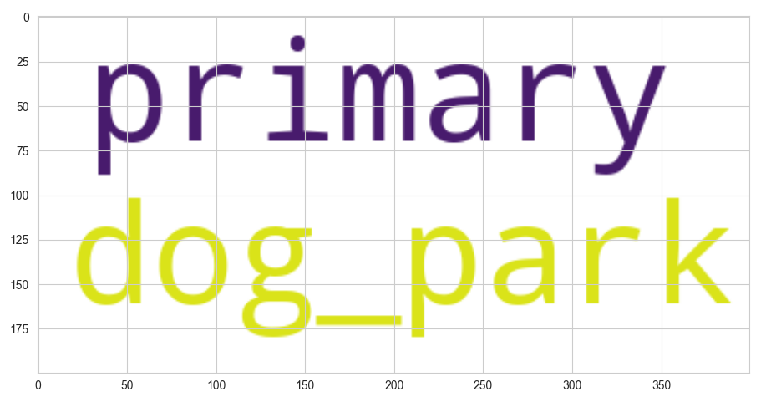
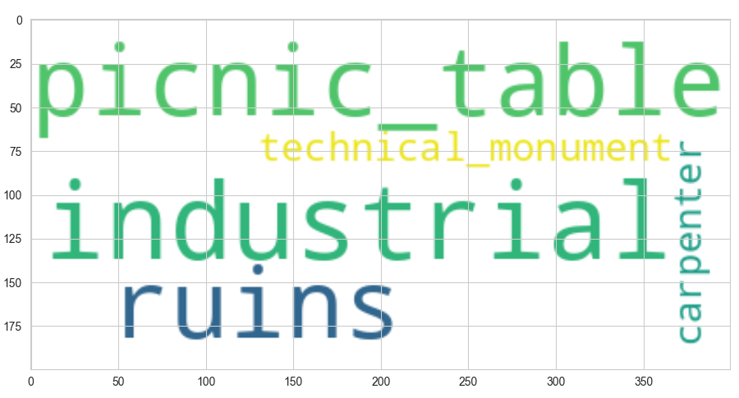
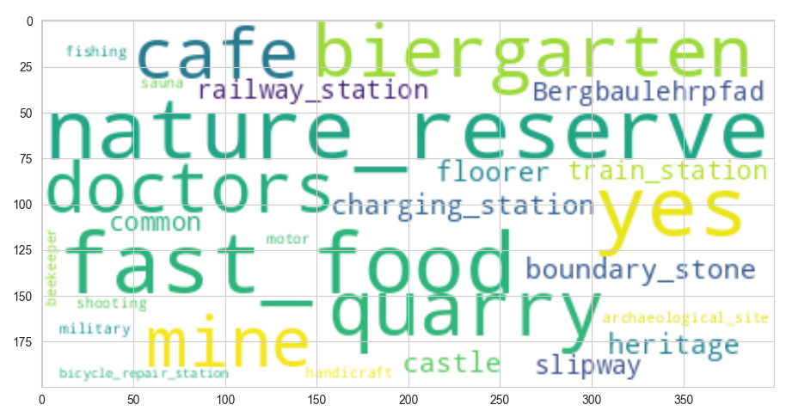
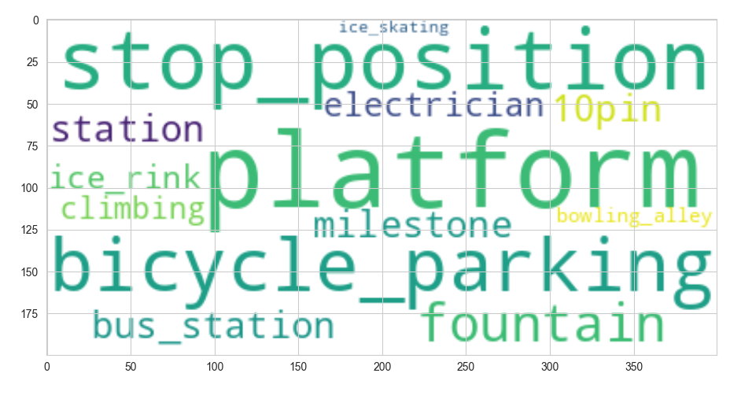

Slide 14
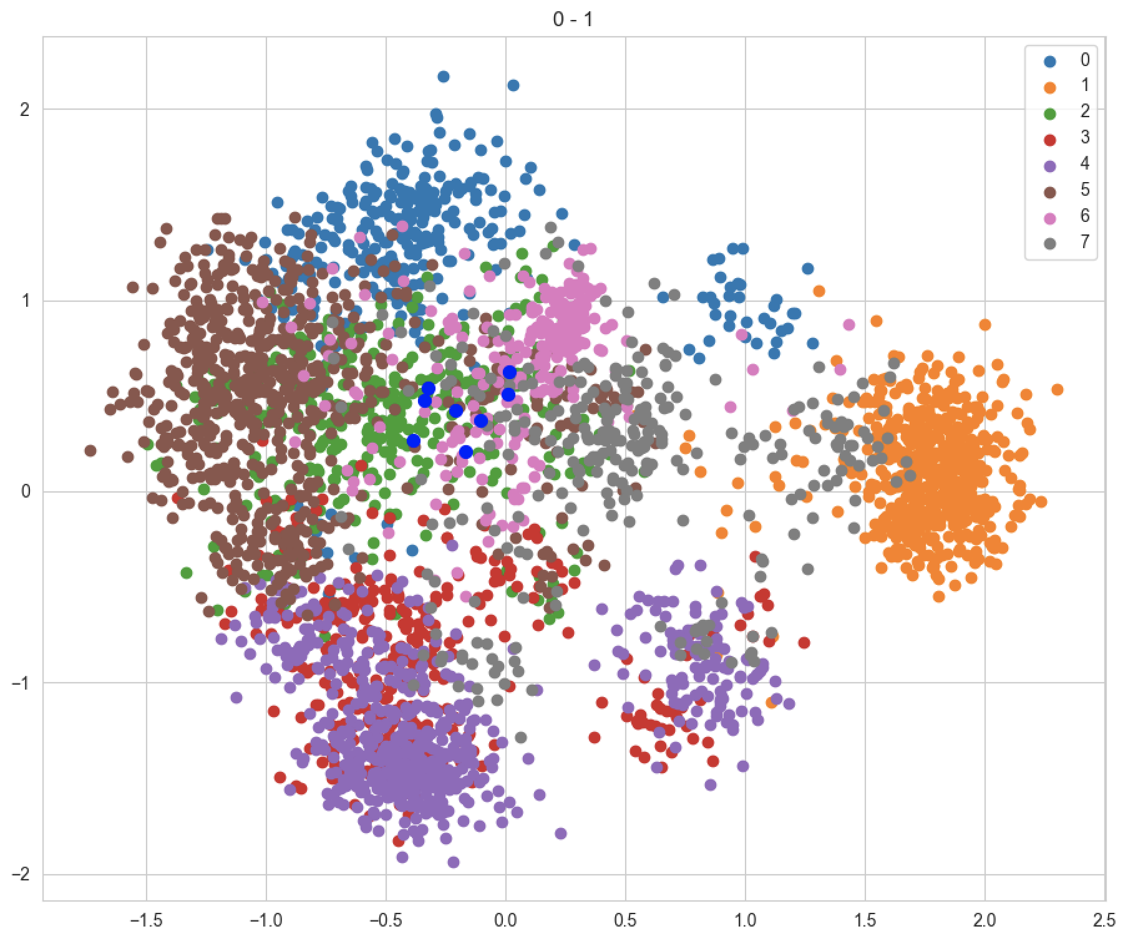

Slide 15
GeoQB Assets

Slide 16
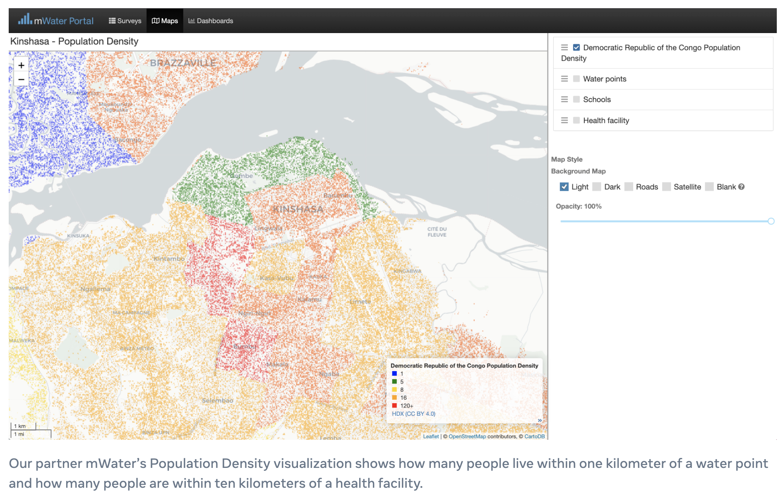
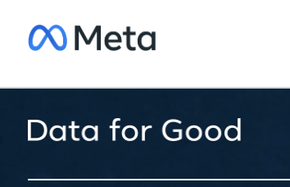

Slide 17
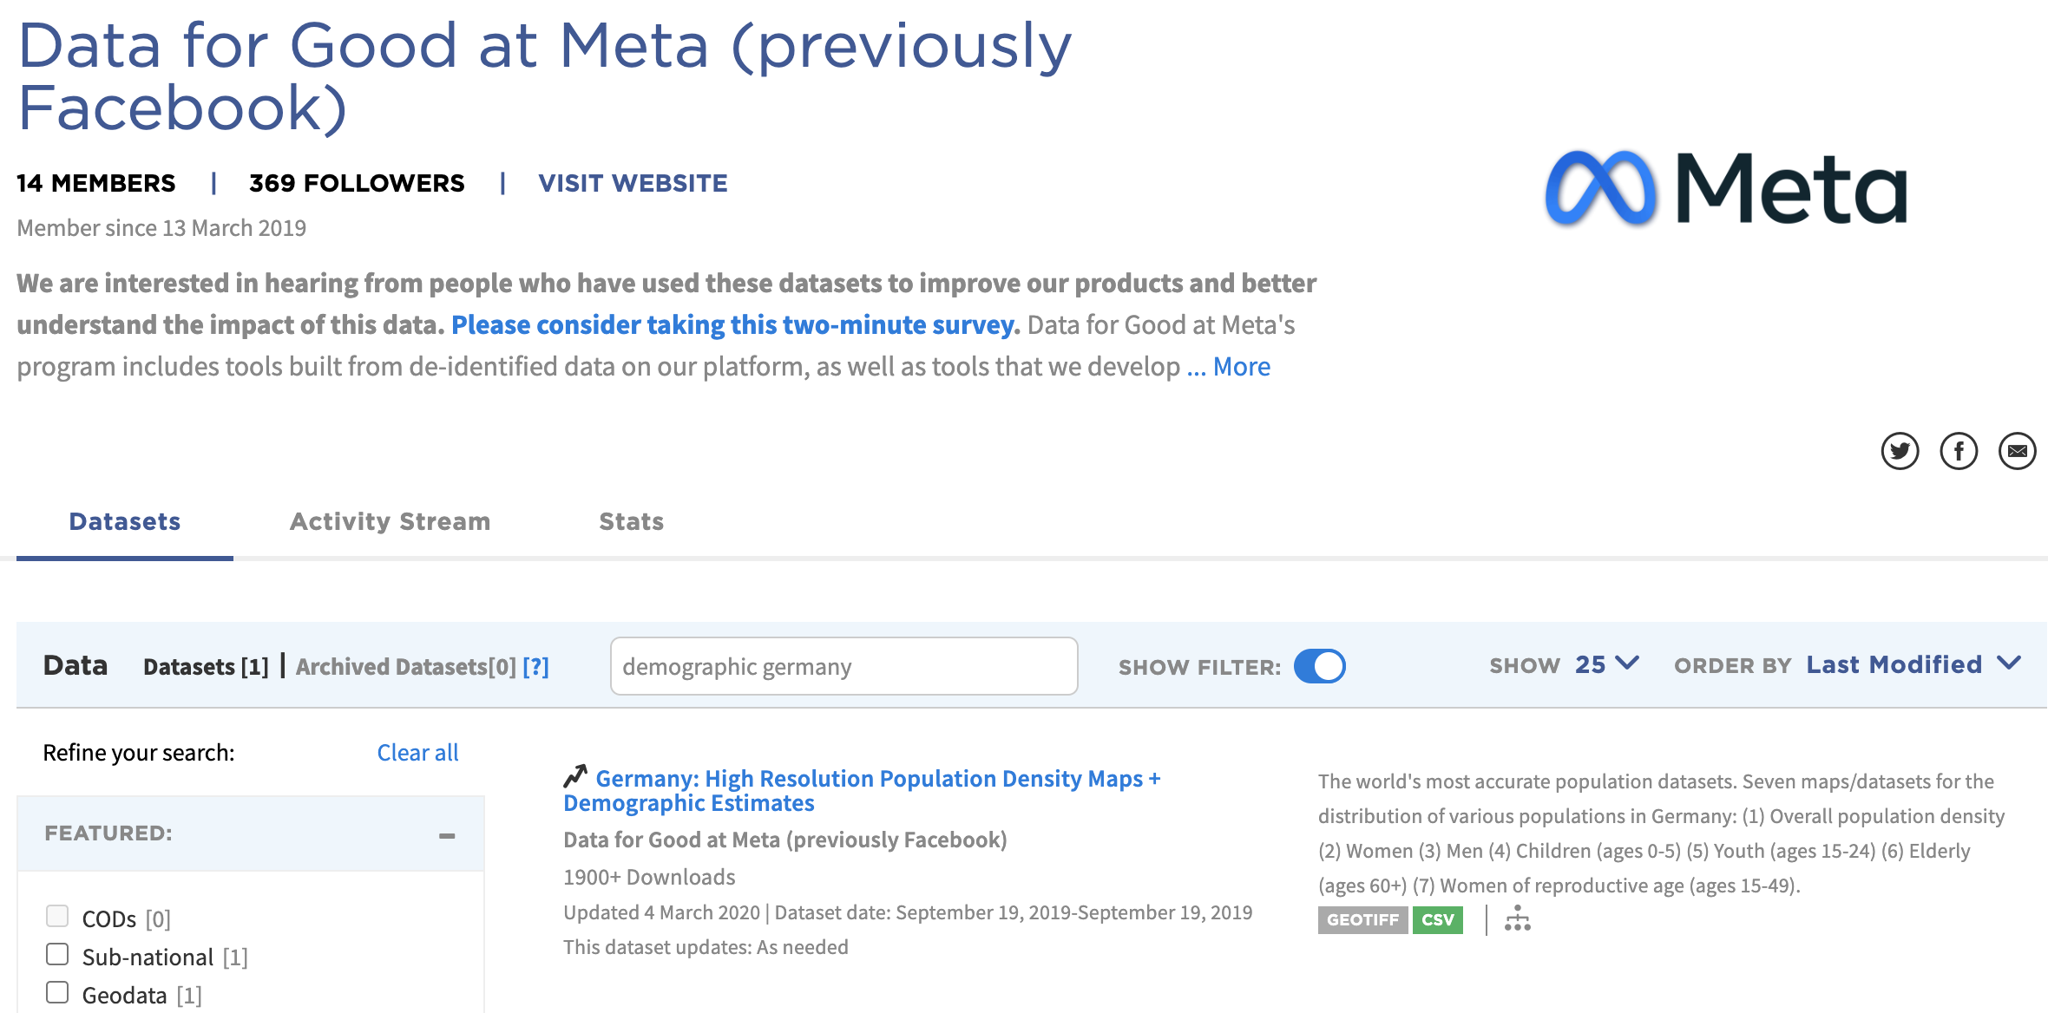

Slide 18
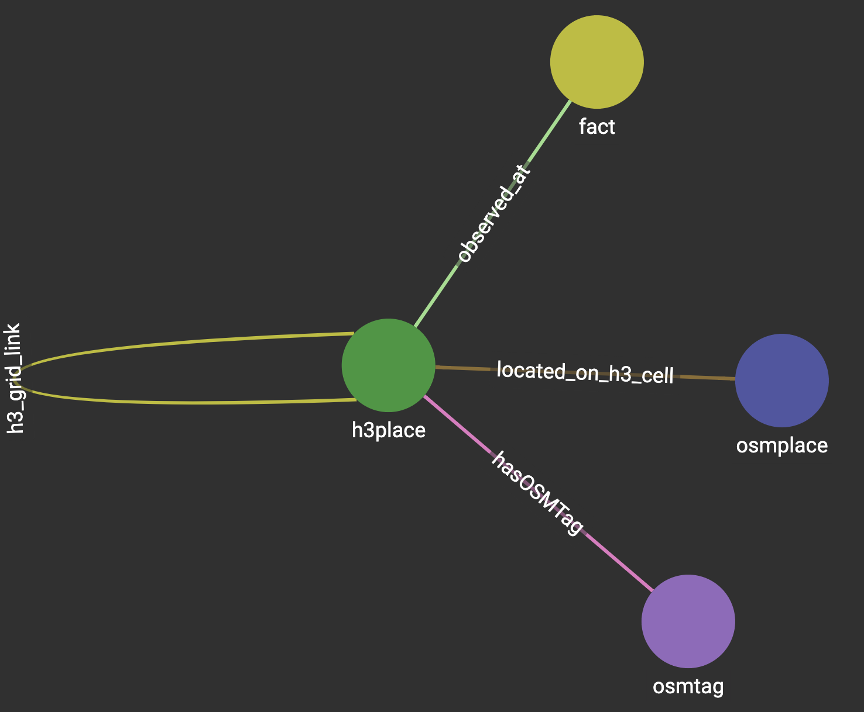
Data Blending …
Observations are added as links bet-ween the place of the observation and an observation-type node. Time and values are modeled as edge properties.

Slide 19
GeoQB Workspace

Slide 20
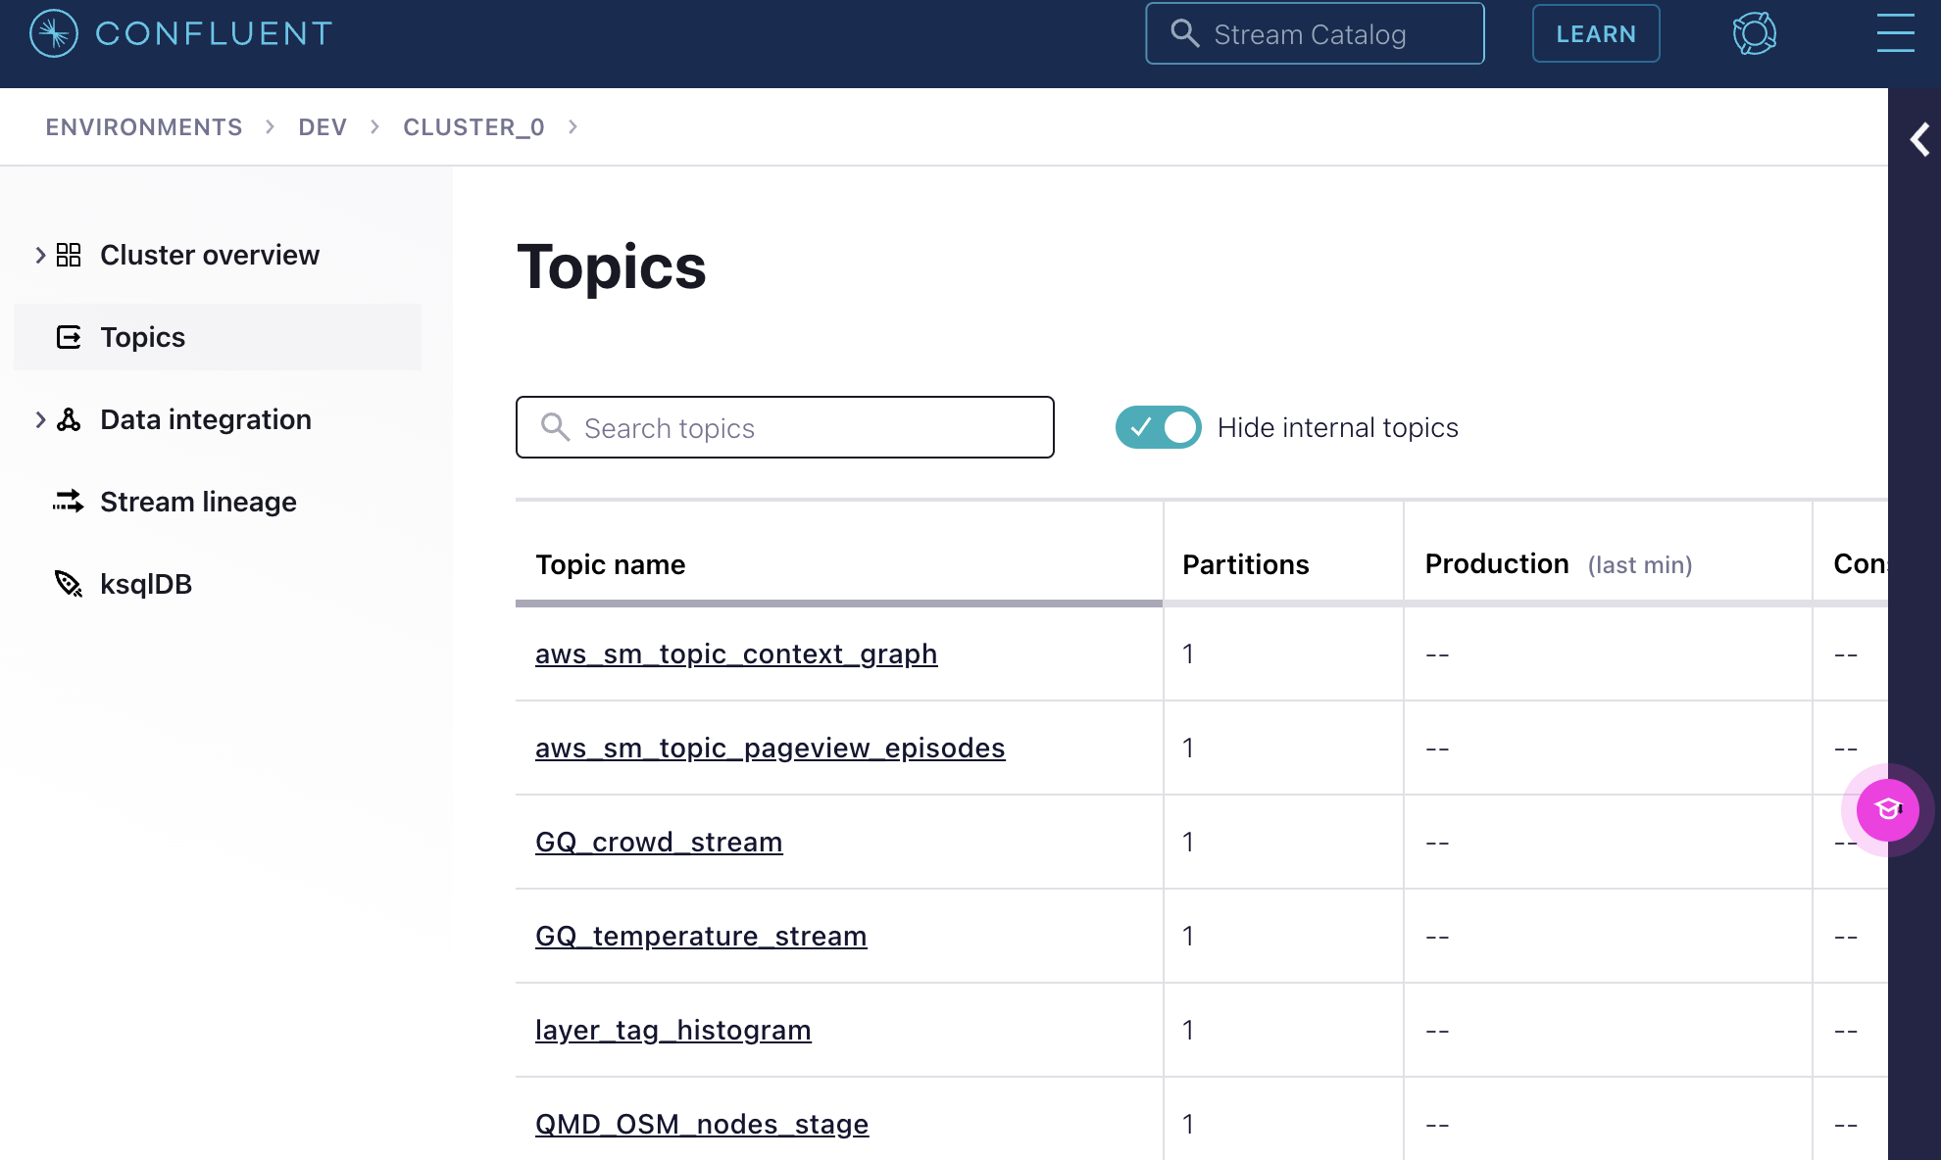
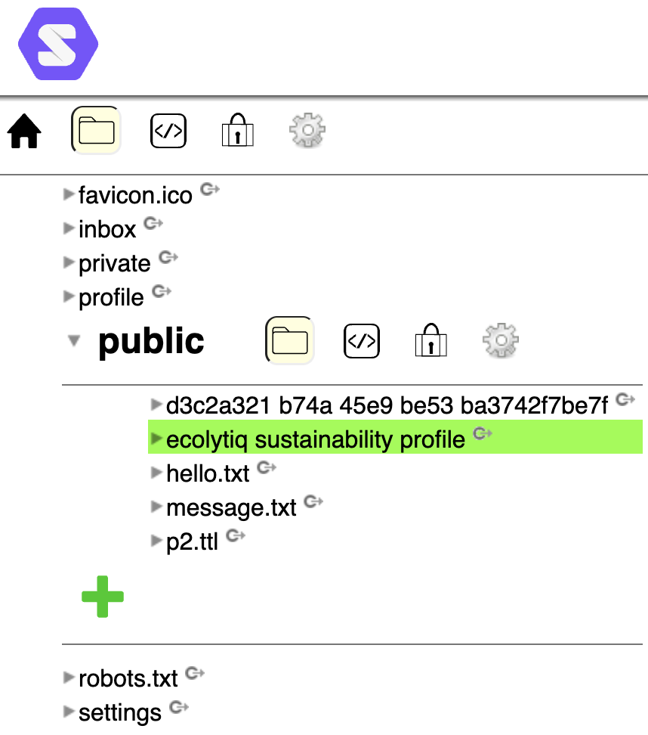
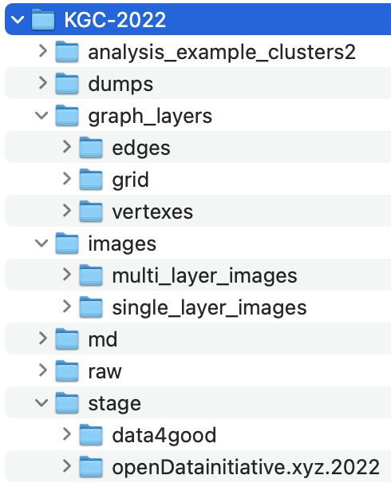
Files + Data Streams + Shared Assets

Slide 21
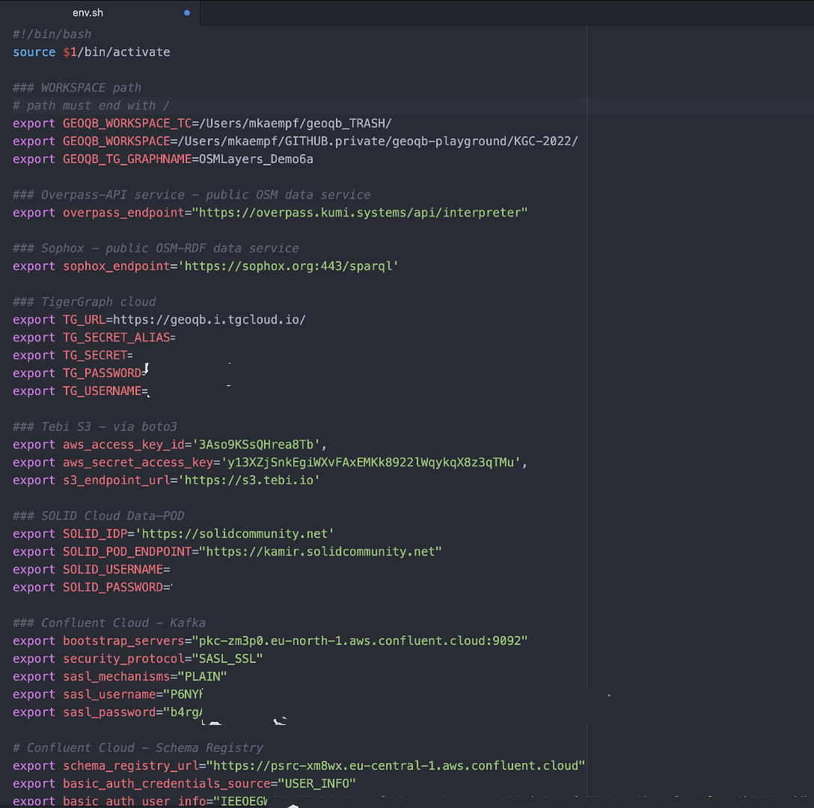
Technical Integration
configure access to remote data assets via ENV variables
use existing client integrations to read data from SPARQL endpoints, REST APIs, or even Apache Kafka topics.

Slide 22
Using the CLI

Slide 23
